Slide 1

Image classification
2020/02/25 | Final Project | CIS-544 DATA MINING & MACHINE LRNG | Max Franke & Damian Etchevest

Slide 2
Agenda
1
Data
2
Approach
3
Results

Slide 3
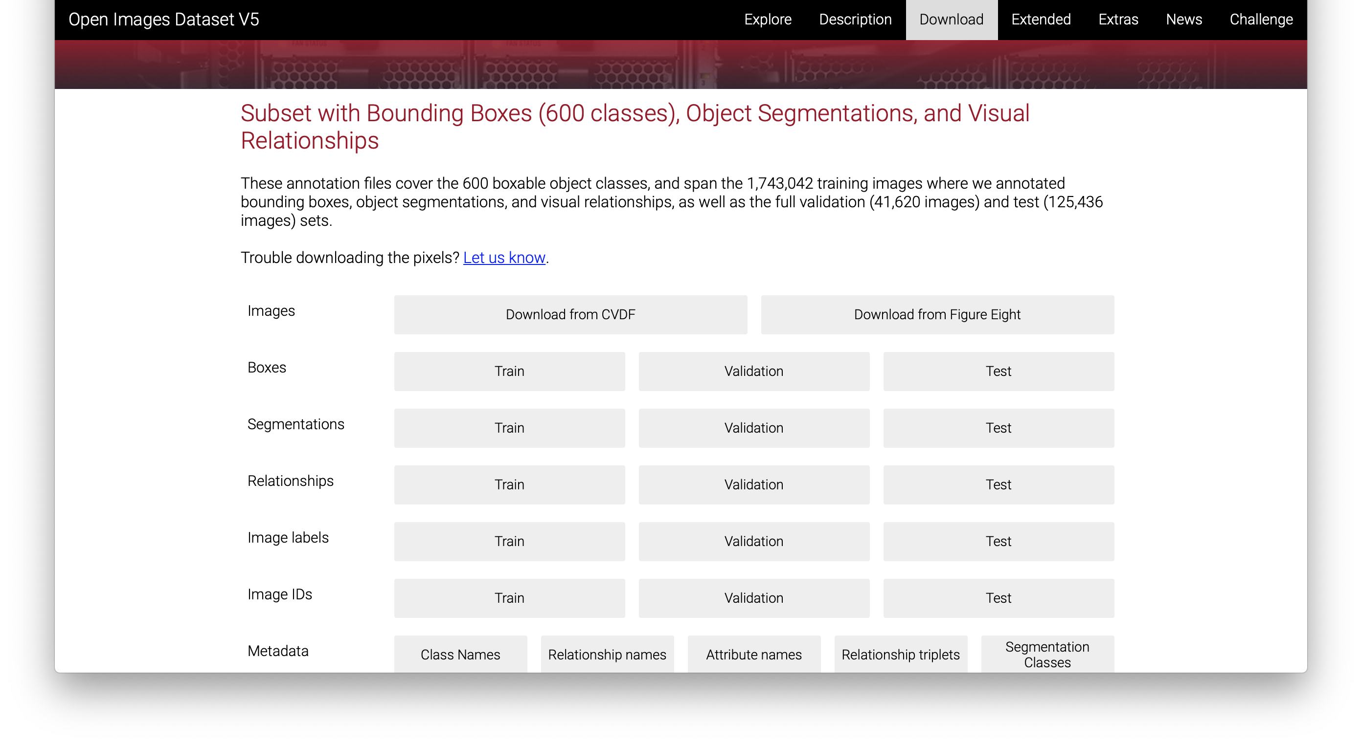

Data is available online (subset of data)
example of image

Slide 4
Approach for this project is divided into three parts
Input = Images
Transform the images
Model building and prediction
Naïve Bayes
Support vector machine
deep learning (neuralnet)
Extract the pixels
Connect the classes with the images
Performance Measurement
Accuracy
Random forest
ROC (Overfitting)

Slide 5

Results of 4 models: Support vector machine has the highest accuracy
Accuracy
Receiver Operating Characteristic (ROC)
There is sufficient evidence to warrant rejection of the claim that the Accuracy from the models are equal(p-value <2*10-¹⁶)
(TukeyHSD Test: NaiveBayes is significant differnt).
Result ROC: Sensitivity / specificity shows low AUC values

Slide 6
SVM and random Forest shows signs for overfitting
SVM*:
*: Support Vector Machine

Slide 7
THANK YOU
2020/02/25 | Final Project | CIS-544 DATA MINING & MACHINE LRNG | Max Franke & Damian Etchevest

